Slide 1
Convolutional Neural Network For Image Classification
Luke Henry, Rachel Verhoef, Joelle Godwin

Slide 2
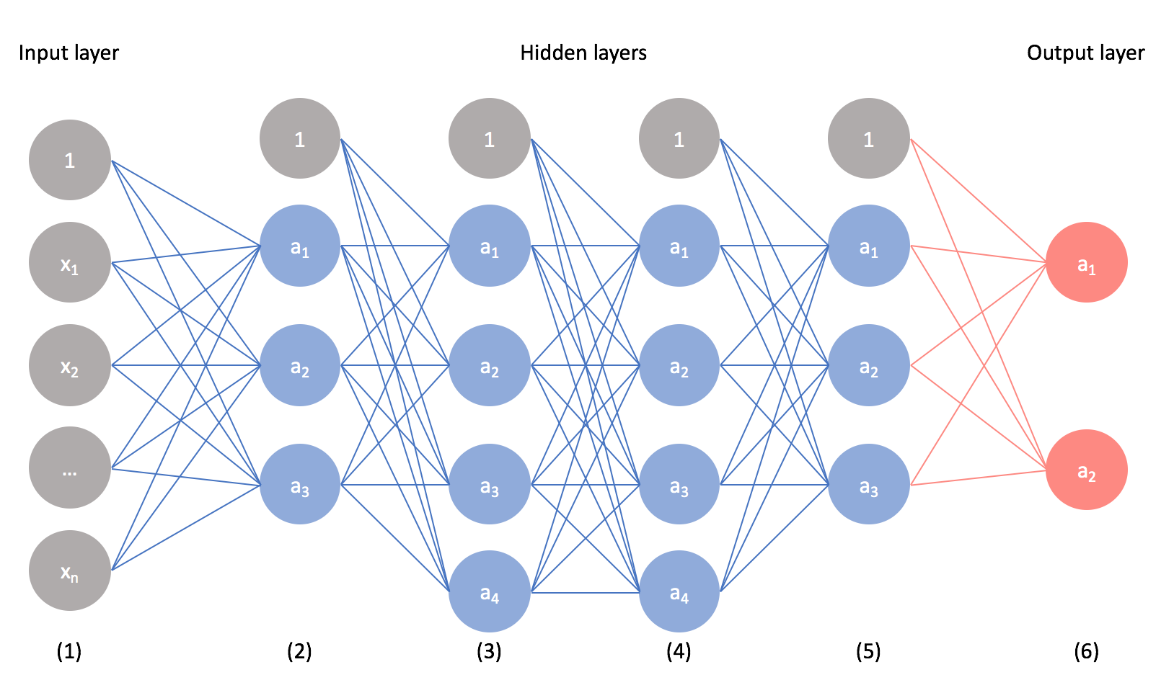
What is a CNN?
A convolutional neural network (CNN) is a type of neural network commonly used in image processing and computer vision tasks. It is designed to recognize patterns in visual input by applying a series of convolutional filters to an image.
Notes:
Joelle

Slide 3
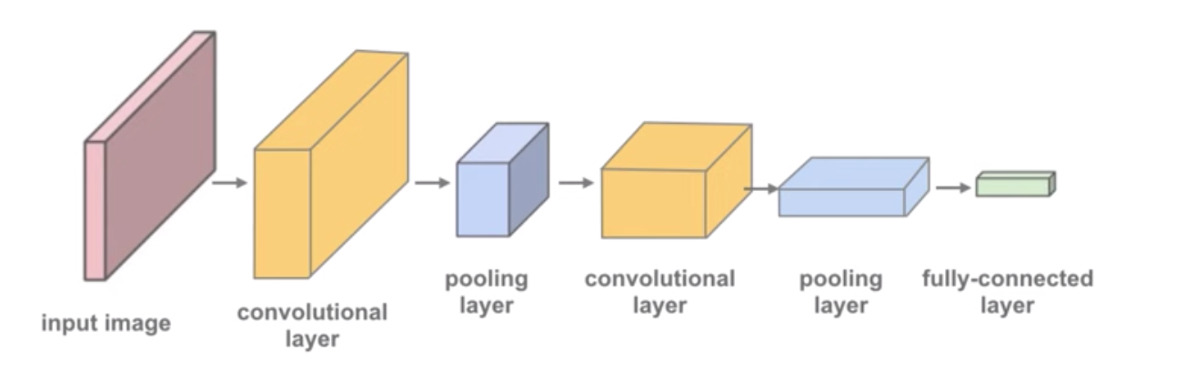
How does a CNN work
Convolutional Layers: The CNN receives an input image and applies multiple convolutional layers where each layer applies a set of filters to the input and produces a new set of feature maps that highlight increasingly complex patterns. Each filter slides over the image and performs a mathematical operation called convolution.
Pooling Layers: These layers downsample the feature maps taken from the convolution layer, reducing their spatial dimensionality while preserving important features.
Fully Connected Layers: Finally, the feature maps, extracted from the previous layers are passed through one or more fully connected layers. These layers use the features extracted by the convolutional and pooling layers to make a prediction about the input image.
Notes:
Rachel
Convolutional layer: The convolutional layer determines the output of neurons, or feature maps, which are connected to local regions of the input through the calculation of the scalar product between their weights and the region connected to the input volume. The parameters of this layer focus on the use of learnable kernels, usually small and odd numbered in spatial dimensionality but spreads the entire depth of the input by a specified stride. For each value in the kernel, the scalar product is calculated. The network will learn of the kernels that signal a specific feature, given at a spatial position, of the input, properly known as activations.
Pooling layer: will simply perform downsampling along the spatial dimensionality of the given input, further reducing the number of parameters within that activation as well as the computational complexity of the model
Fully-connected layer: used to convert the features extracted by the convolutional and pooling layers into class scores, probabilities, or other values. Receiving a one-dimensional vector of features that have been flattened from the output of the previous layers. The amount of neurons in this layer is typically much smaller than those in previous layers. Each neuron in this layer calculates a weighted sum of the inputs from the previous layer, adds a bias term, and applies an activation function, such as ReLU (rectified linear unit) or the sigmoid function, to produce the output of the neuron

Slide 4
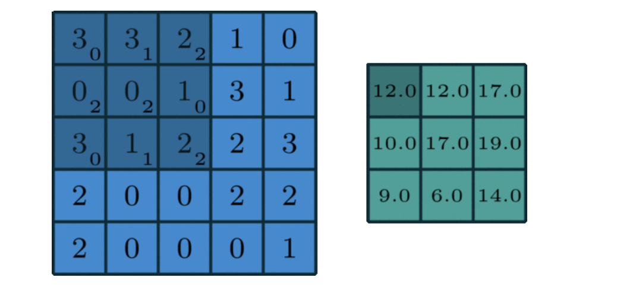
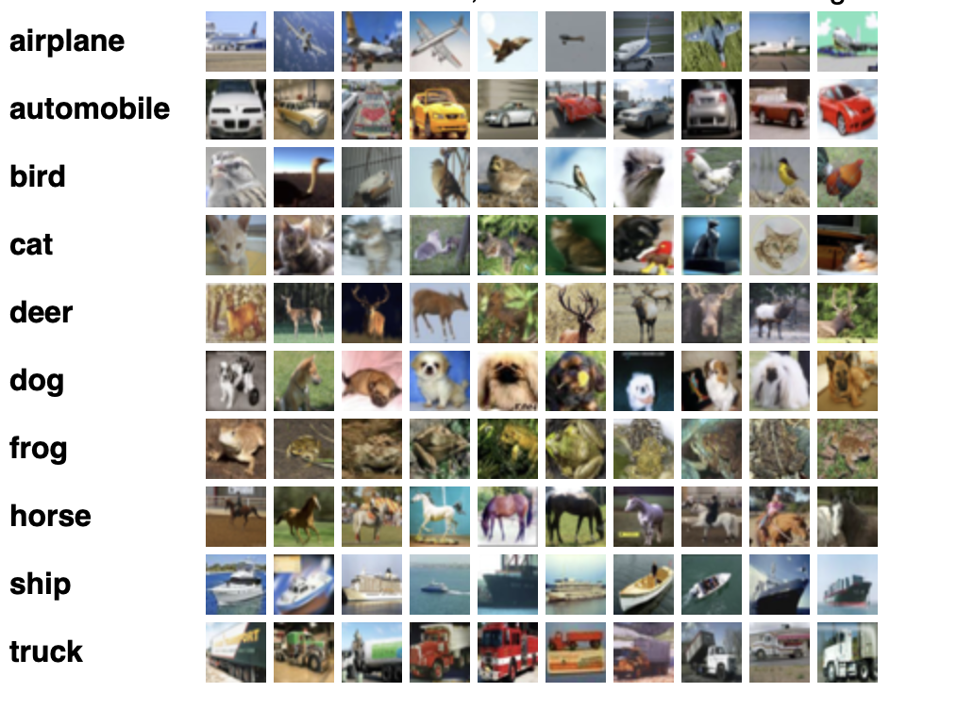
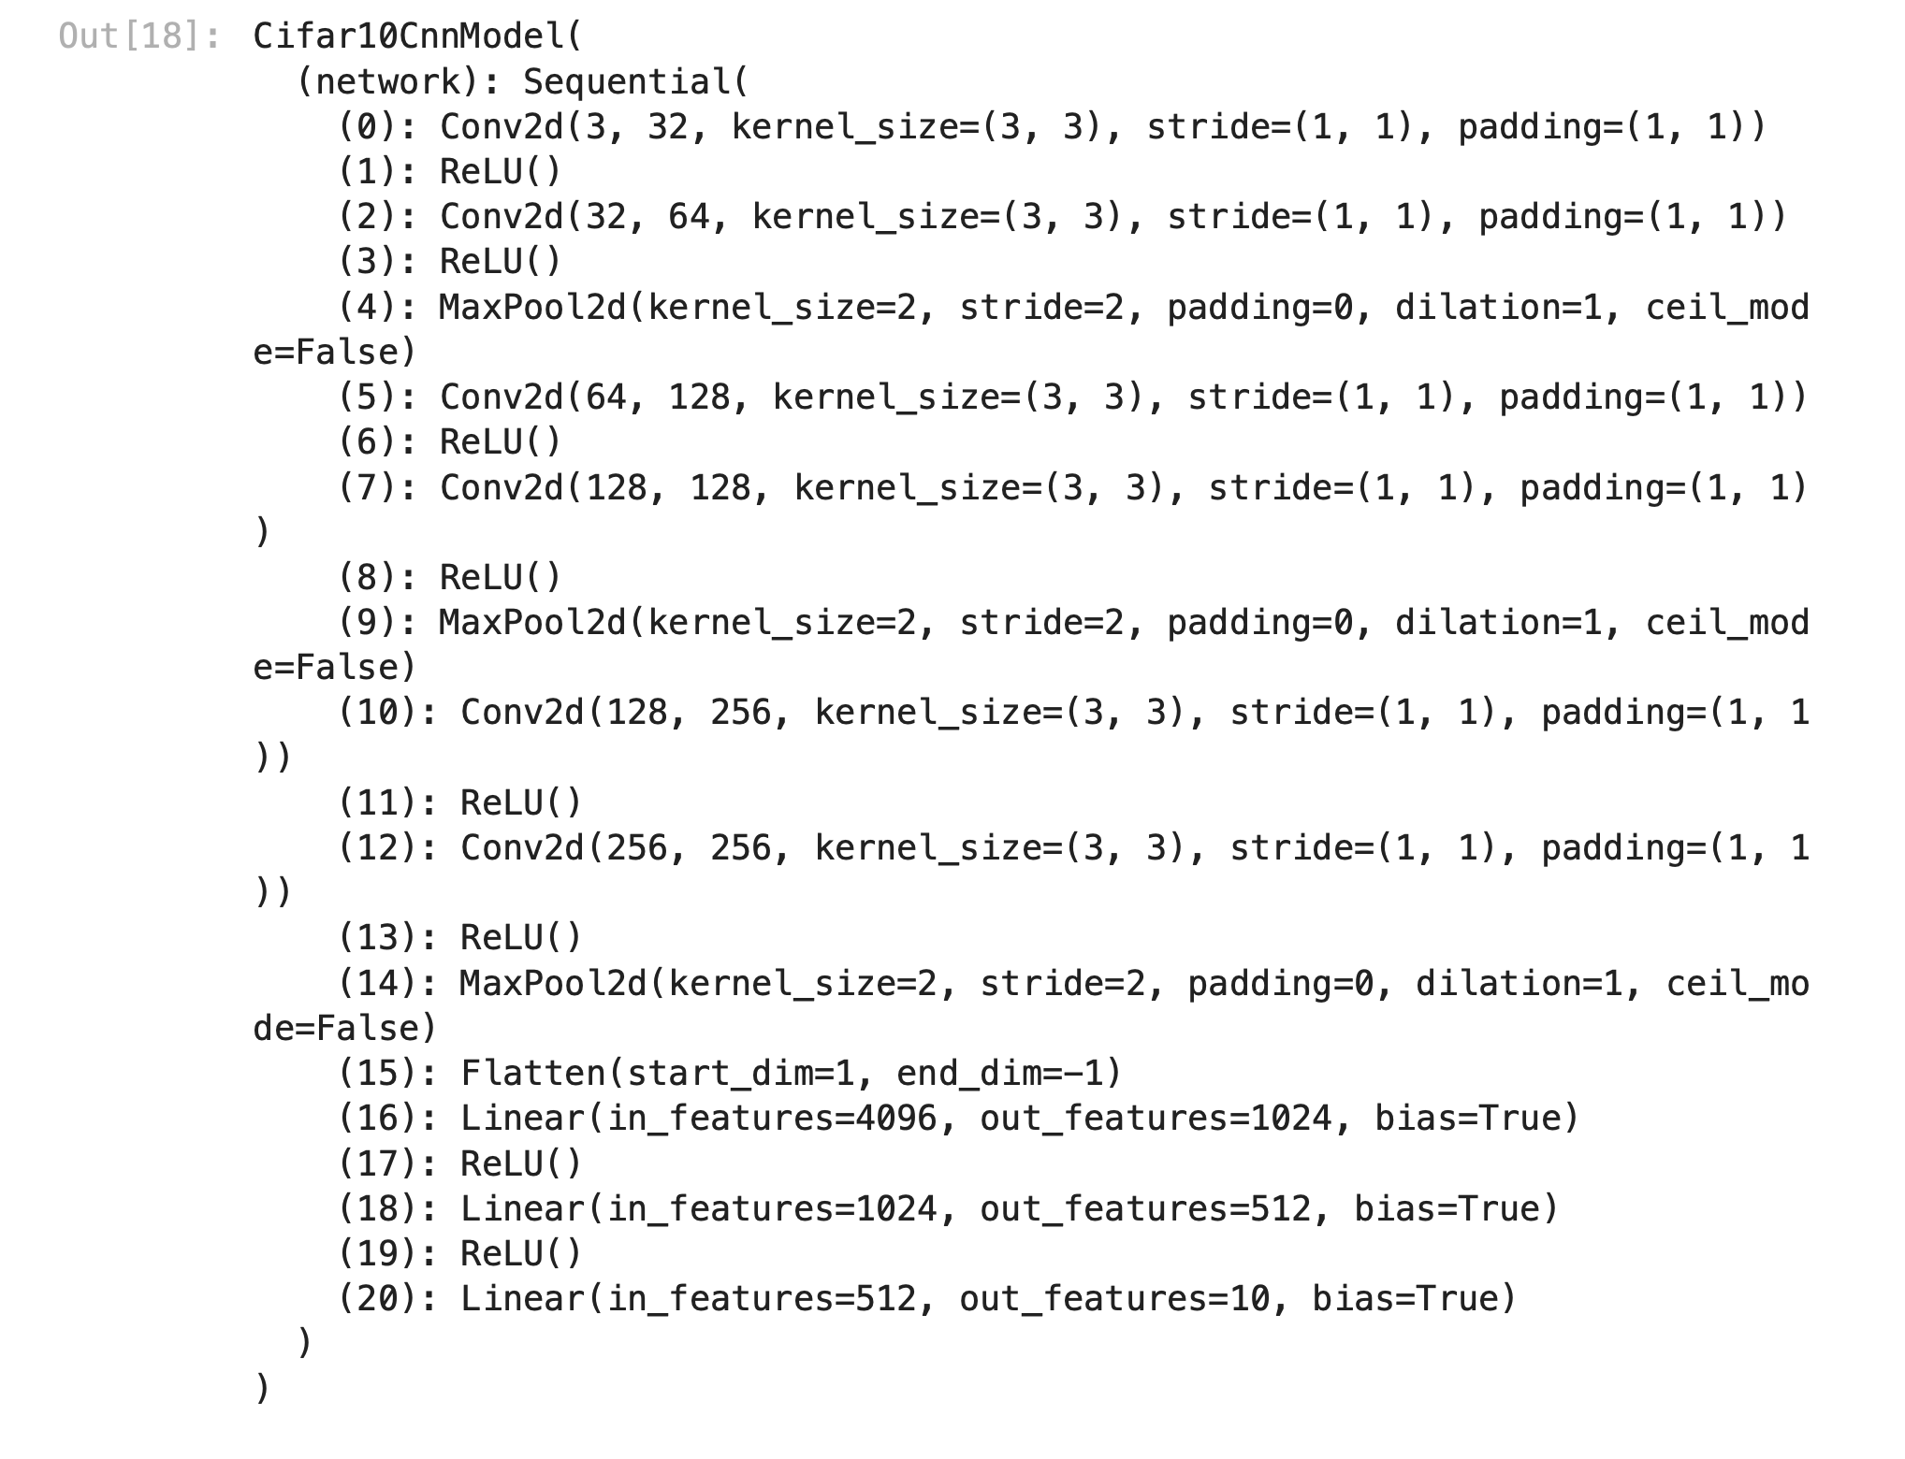
How we made ours
We chose to use the CIFAR-10 dataset
Consisting of 60000 total 32x32 images
10 different categories →
Why we chose the PyTorch library (not only because TensorFlow was having issues working) because PyTorch is a versatile library that provides good platform building for CNNs
3 Classes
ImageClassificationBase - helper methods for training and validation
Cifar10CnnModel - used to make our model and chain layers and activation functions into a single network
DeviceDataLoader - used to instantiate our data loaders, which were used for working with the CIFAR-10 dataset
Notes:
The 2D convolution is a fairly simple operation at heart: you start with a kernel, which is simply a small matrix of weights. This kernel “slides” over the 2D input data, performing an elementwise multiplication with the part of the input it is currently on, and then summing up the results into a single output pixel.
Kernels make the matrices, padding extends the area of an image, increases the step size of the filter that is being slid over the image. In general a channel is transmitting information using signals (A channel has a certain capacity for transmitting information) For an image these are usually colors (rgb-codes) arranged by pixels, that transmit the actual information to the receiver.
Conv2d: in channels and out channels: 3,32 & 32,64 = 64 x 16 x 16. 64,128 & 128,128 = 128 x 8 x 8. 128,256 & 256,265 = 256 x 4 x 4
ReLU helps to prevent the exponential growth in the computation required to operate the neural network. If the CNN scales in size, the computational cost of adding extra ReLUs increases linearly.
Flattening is used to convert all the resultant 2-Dimensional arrays from pooled feature maps into a single long continuous linear vector.
The matrix picture is downsampling

Slide 5
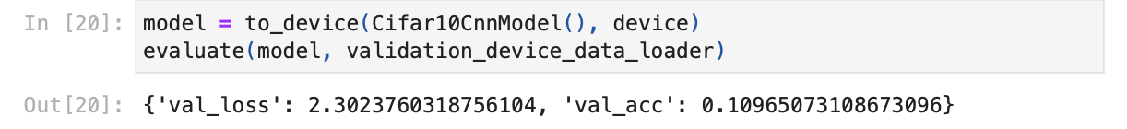
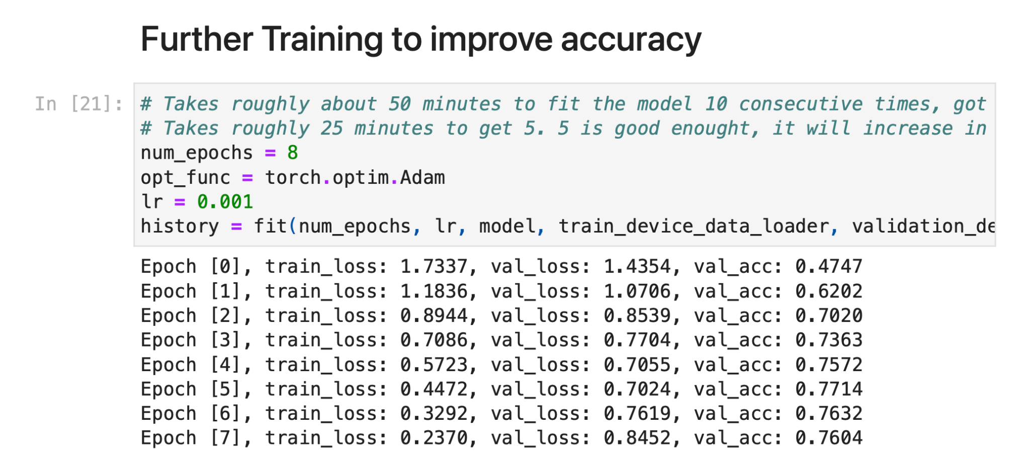
Training with Epochs
We starting off training the model one time and then evaluating the accuracy
After that we fit it with multiple epochs to make sure to get through the entire data set to more accurately fit the model
Notes:
Luke

Slide 6
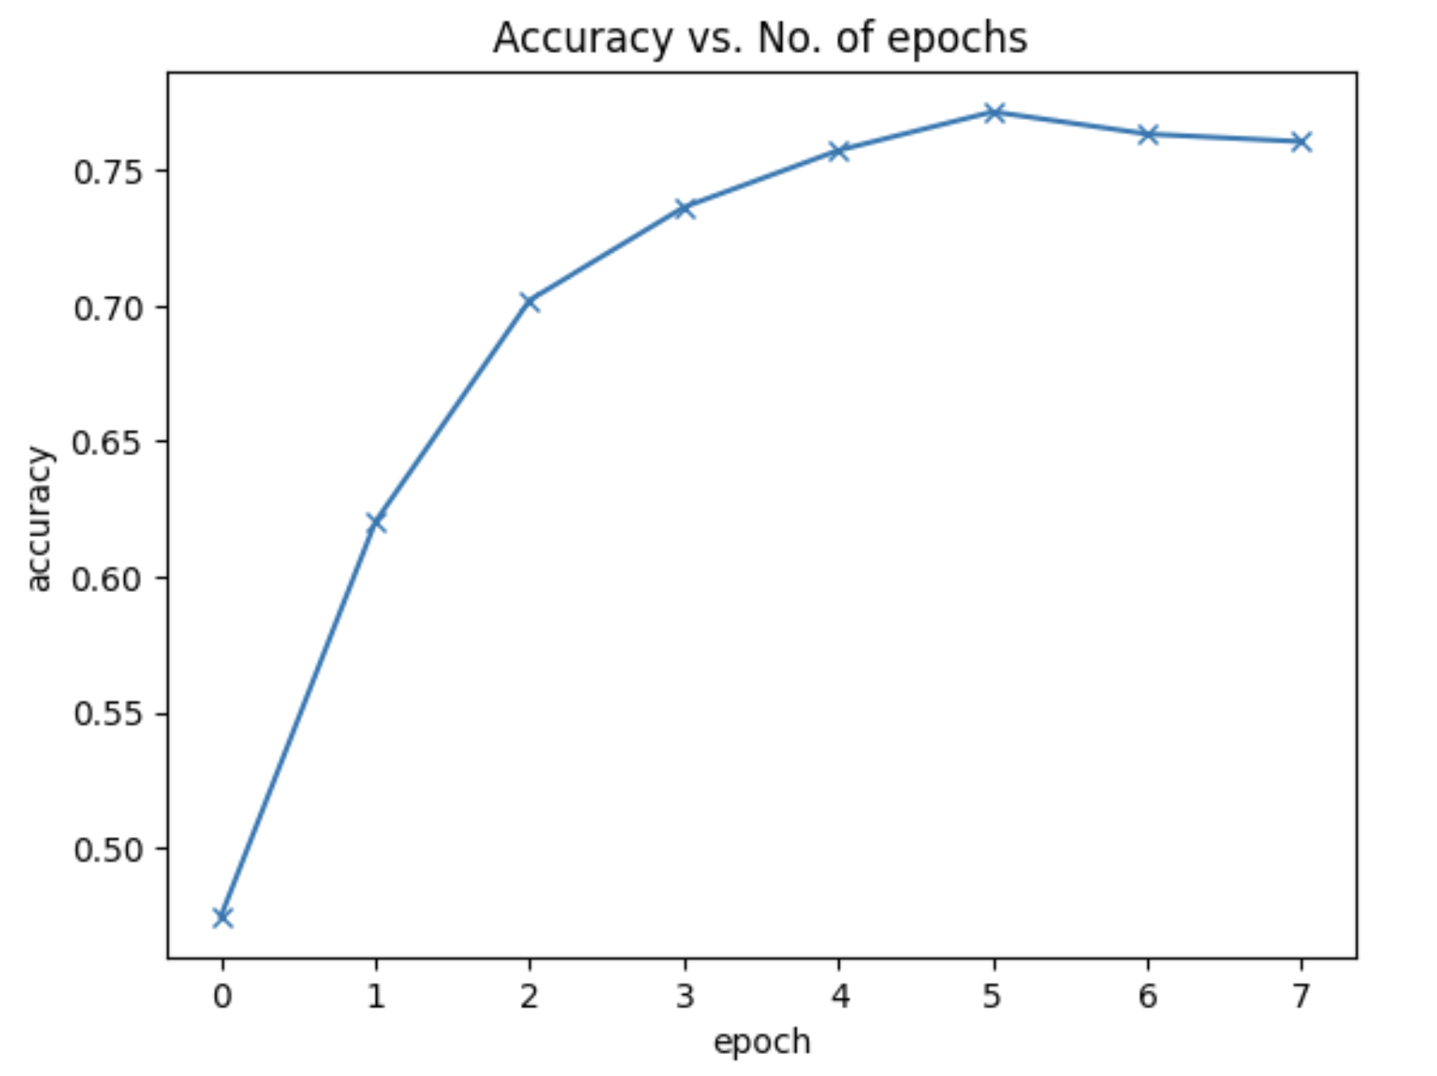
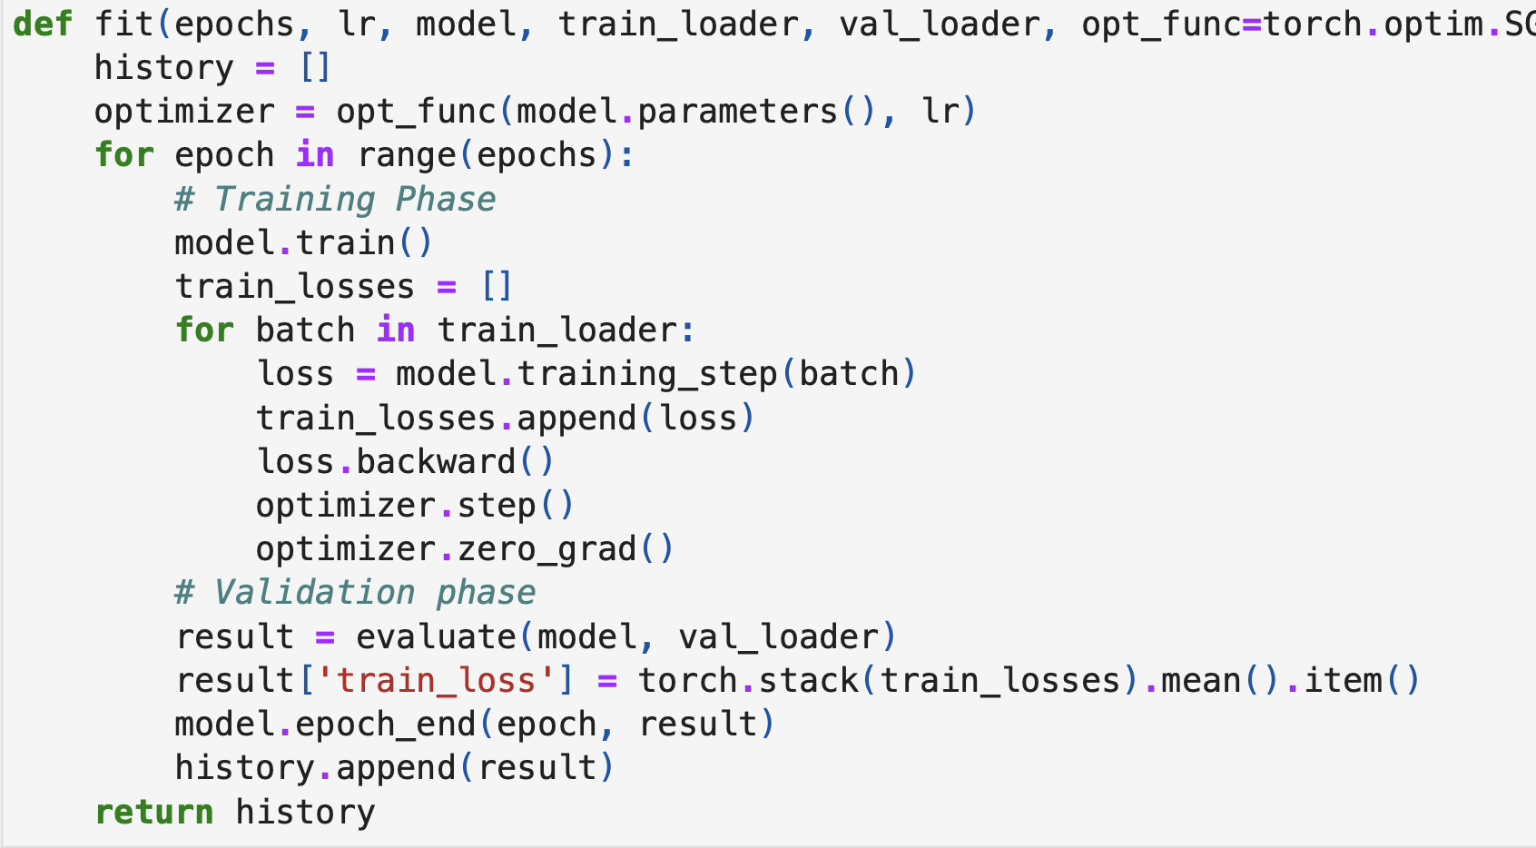

Slide 7
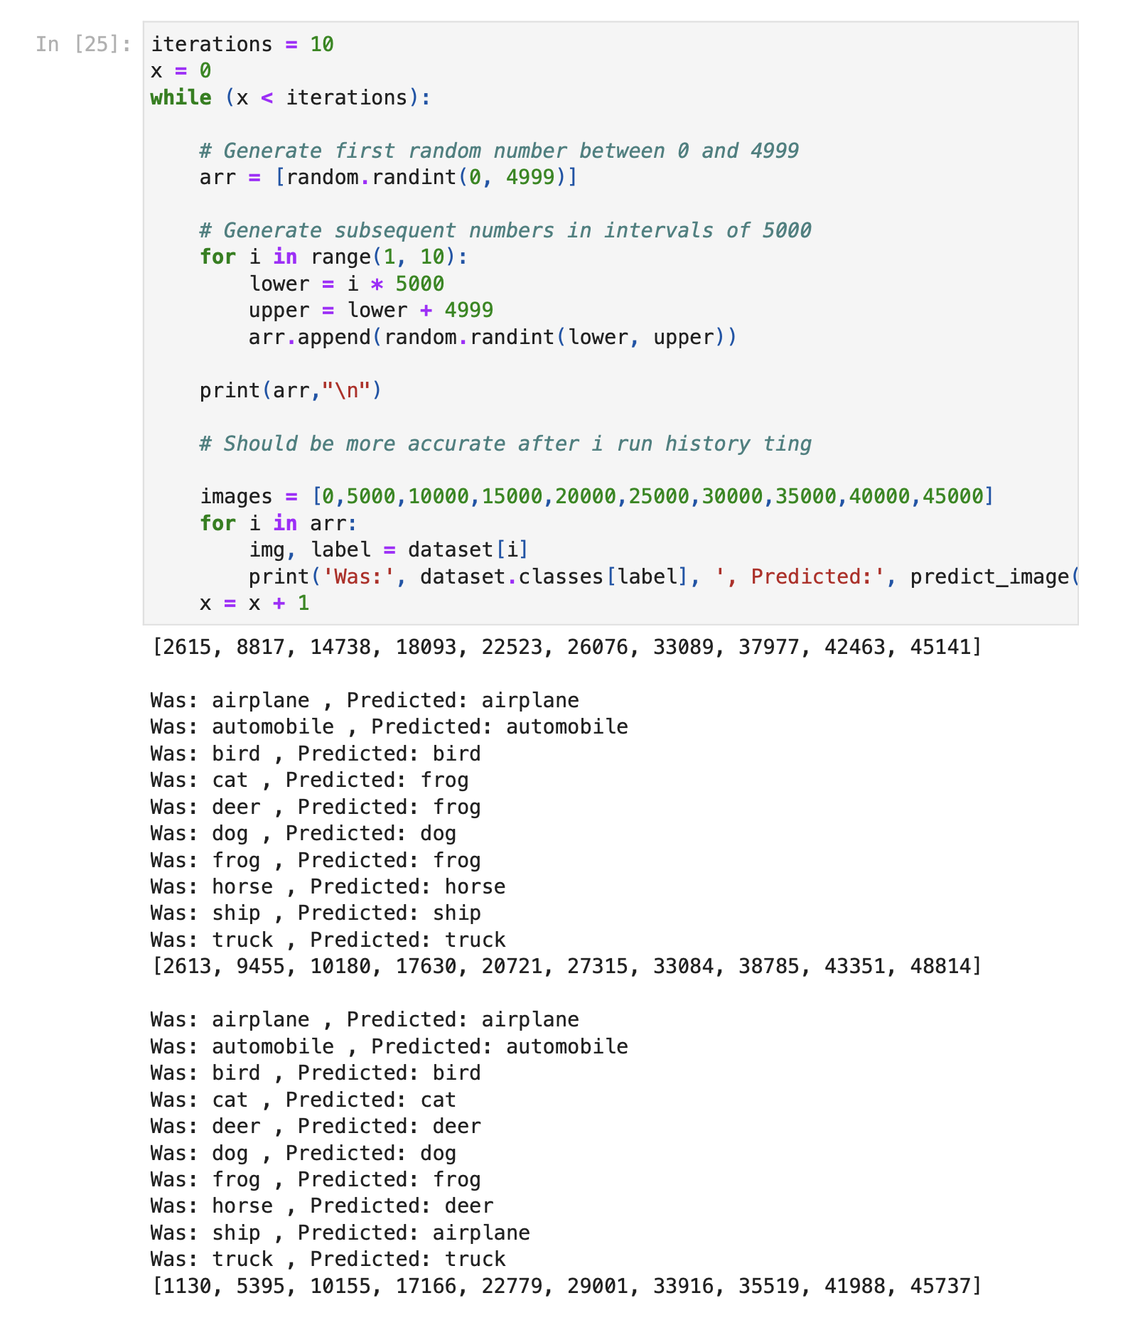
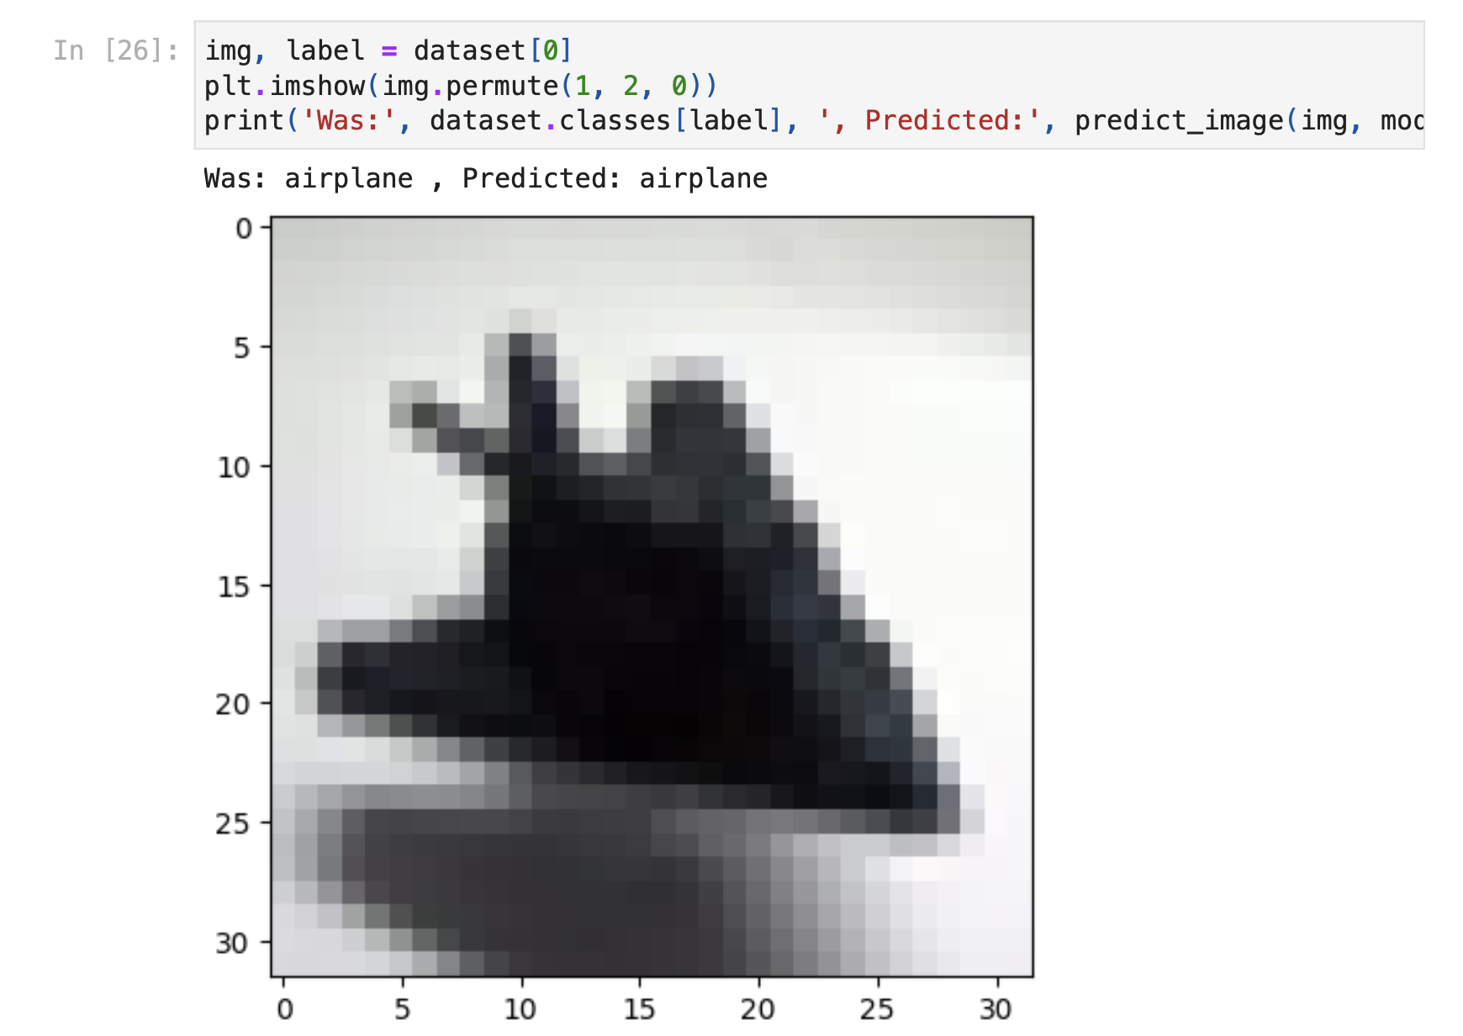
Image Recognition Testing
We realised that some pictures are generally easier to recognize than others
Loop through random cases for all 10 categories (left)
One specific test for the first picture of each class (right)
Notes:
Luke

Slide 8
Overview of Our Findings
CNN is a very complex neural network
A CNN breaks the pixelated images down evaluated the weights kernel by kernel
It is a reliable machine learning algorithm and is one of many algorithms that is able to work with image recognition learning
Just as much as a CNN is reliable it is costly
Compared to labs in the past this was the most hardware and time consuming to get a decent accuracy score
Fitting with 8 epochs took between 30-45 minutes
In our experience, there was a limit to about 80% accuracy in our model, so the ability to guess every image is not guaranteed no matter how much time we dedicate to training
Notes:
Rachel/Joelle

Slide 9
References
What is a CNN:https://www.ibm.com/topics/convolutional-neural-networks
How does a CNN work:https://towardsdatascience.com/basics-of-the-classic-cnn-a3dce1225add
CIFAR-10:https://www.cs.toronto.edu/~kriz/cifar.html
PyTorch /nn.Conv2d Documentation:https://pytorch.org/docs/stable/torch.html, https://pytorch.org/docs/stable/generated/torch.nn.Conv2d.html
Epochs: https://machinelearningmastery.com/difference-between-a-batch-and-an-epoch/#:~:text=at%20an%20epoch.-,What%20Is%20an%20Epoch%3F,update%20the%20internal%20model%20parameters.

